Slide 1
Probability
EQ – How do I calculate probabilities of combined events using tree diagrams?
Year 10 Mathematics

Slide 2
Lesson objective
By the end of this lesson you will be able to;
Constructs and uses tree diagrams to calculate probabilities
B grade and above: Constructs and uses tree diagrams to calculate probabilities in situations involving replacement and where there is no replacement
Notes:
Lesson

Slide 3
24
7
30
Topic: Probability
Date: 11/06/2018
EQ – How do I calculate probabilities of combined events using tree diagrams?
Tree diagrams are another useful way of listing the sample space of two or more events. Each outcome is represented on a “branch”.
Branch probabilities are used to describe the chance of each outcome at each step.
The probability of each outcome for the experiment is obtained by multiplying the branch probabilities.
Branch probabilities will depend on whether selection is made with or without replacement.
For with replacement, probabilities do not change.
For without replacement, probabilities do change.
What is a tree diagram?

Slide 4
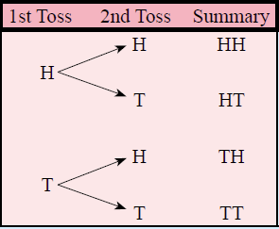

24
7
30
Topic: Probability
Date: 11/06/2018
EQ – How do I calculate probabilities of combined events using tree diagrams?
Example – With Replacement
For a coin toss we can have a heads or a tails. What happens if we toss two coins?
What is a tree diagram?
There are four outcomes
Heads then Heads = $\frac{1}{4}=$ 0.25 = 25%
Heads then Tails = $\frac{1}{4}=$ 0.25 = 25%
Tails then Heads = $\frac{1}{4}=$ 0.25 = 25%
Tails then Tails = $\frac{1}{4}=$ 0.25 = 25%

Slide 5




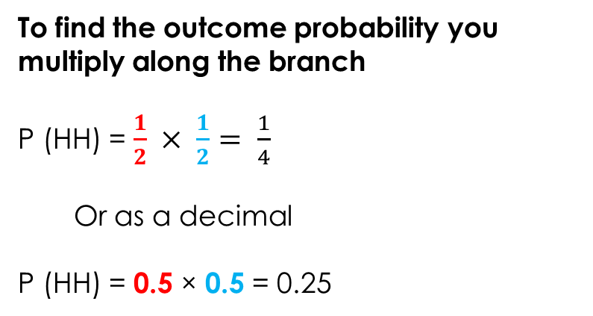


24
7
30
Topic: Probability
Date: 11/06/2018
EQ – How do I calculate probabilities of combined events using tree diagrams?
Using the same example as before:
How do I calculate the probability of combined events?
What was the probability of getting heads or tails for the first toss?
What was the probability of getting heads or tails for the second toss?
$$\frac{1}{2}$$
To find the outcome probability you multiply along the branch
P (HH) = $\frac{1}{2} × \frac{1}{2}= \frac{1}{4}$
Or as a decimal
P (HH) = 0.5 × 0.5 = 0.25
$$\frac{1}{2}$$
$$\frac{1}{2}$$
$$\frac{1}{2}$$
$$\frac{1}{2}$$
$$\frac{1}{2}$$

Slide 6





24
7
30
Topic: Tree Diagrams
Date: 28/05/2018
EQ – How can we show two step problems with tree diagrams?
Using the same example as before:
What was the probability of getting heads or tails for the first toss?
We know these are the 4 outcomes
Heads then Heads = 0.25
Heads then Tails = 0.25
Tails then Heads = 0.25
Tails then Tails = 0.25
How do you calculate the probability from a tree diagram?
What was the probability of getting heads or tails for the second toss?
$$\frac{1}{2}$$
To find the outcome probability you multiply along the branch
P (HH) = $\frac{1}{2} × \frac{1}{2}= \frac{1}{4}$
Or as a decimal
P (HH) = 0.5 × 0.5 = 0.25
$$\frac{1}{2}$$
$$\frac{1}{2}$$
$$\frac{1}{2}$$
$$\frac{1}{2}$$
$$\frac{1}{2}$$

Slide 7
Task
Tree Diagram Introduction Activity Worksheet
Dwyer Year 10 Text, Exercise 8.1, Questions 1-4, p.104

